Slide 1
About this lecture...
CPU organization
Basic CPU operations
Control signals for CPU operations

Slide 2
How is a program executed?
We know that a program is a sequence of instructions. In order to execute a program, for every instruction, we will have to bring the instruction from main memory.
find out what operation has to be performed by the instruction
communicate with memory and other de­vices (if needed) to fetch data.
perform the operation
find out which is the next instruction to be executed
repeat the above steps for the next instruc­tion.

Slide 3
How does CPU execute an instruction?
CPU consists of several general purpose reg­isters, special purpose registers, control unit and ALU.
CPU brings the instruction from main memory to the Instruction Register in instruction fetch stage. To do so, the address of the memory location containing the instruction is available in the PC register.
After fetching an instruction, the PC is in­cremented to point to the next instruction to be executed.
A branch instruction modifies, if needed, the program counter after the execution of the current instruction.
For executing an arithmetic or logic oper­ation, the operands have to be supplied to the ALU.

Slide 4
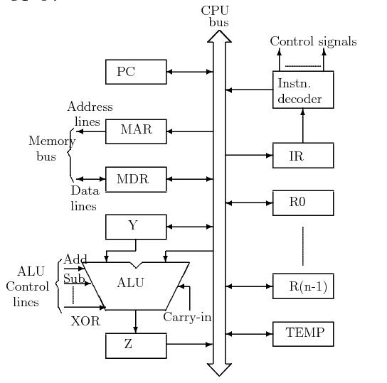
Organization of Central Processing Unit
There are various possible organizations of a CPU. The following figure shows an organization using a single internal bus for the CPU.

Slide 5
Single ­Bus Organization of CPU
MAR : Memory Address Register
MDR : Memory Data Register
PC : Program Counter
IR : Instruction Register
R0­R(n - 1) : General Purpose and Special Purpose Registers.

Slide 6
Y,Z, Temp : Registers transparent to the programmer, cannot be referenced directly in any instruction. Used only for the tem­porary storage during execution of instruc­tions.
All registers (except IR) and the ALU are used for data handling (storage and manip­ulation). These are collectively referred as Data Path.
Instruction Decoder and Instruction Regis­ter are integral part of the control cir­cuitry in the CPU, referred to as Control Path.

Slide 7
Basic CPU Operations
The complete execution cycle of an instruction (fetch, decode, execute) is performed by a sequence of some basic operations of data transfer and arithmetic and logic oper­ations. These basic operations are :
Fetching a word from memory
Storing a word in memory
Register transfers
Performing arithmetic or logic operations

Slide 8
Fetching a word from memory
In order to fetch a word from memory, the CPU has to load the MAR with the address of memory location.
Then it has to issue a read signal to memory.
After some time, memory responds with data which gets stored in MDR.

Slide 9
Storing a word in memory
As in the case of fetching a word, the address of memory location has to be put in MAR.
Data to be stored is loaded into MDR.
A write request is then sent to memory, and CPU waits for write to be over.
CPU holds the address and data active till it is written in the memory.

Slide 10
Timing consideration
Memory functions generally take much longer to complete than a CPU cycle.
In most of the cases, CPU will have to wait for the completion of the memory function before going to the next step.
However, it is possible to initiate the next CPU operation if the operation doesn't need MAR or MDR.

Slide 11
Register Transfer
One of the most common CPU operations.
The data is transferred from one register to another.
To do so, the data is to be put on CPU internal bus from the source register, and loaded in destination register.
Need to provide some type of control mech­anism to ensure that at any instance, at most one register is loading the data bus, al­though several registers can receive the data from the bus simultaneously.
This can be achieved by providing some con­trol signals (or gating signals) to activate a register output to the common bus and to activate a register input from the bus.

Slide 12
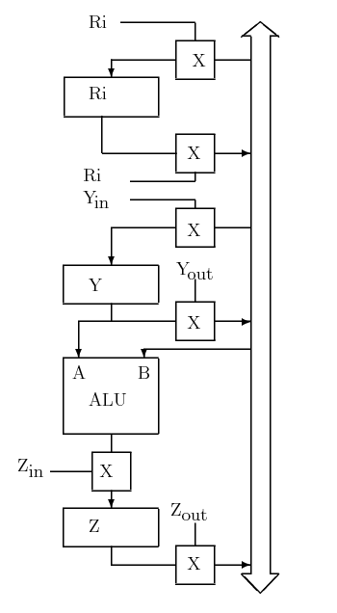
Input/Output Gating

Slide 13
Performing ALU Operation
For performing a binary ALU operation, one of the operands has to be loaded in the CPU internal register Y.
The other operand is gated on the common bus.
ALU is activated to perform the desired function.
After performing the needed operation, the ALU result is loaded in Z register.
Result is put on common bus and trans­ferred to another register.

Slide 14
Execution of an Instruction
Example of execution of a non­ branching in­struction:
ADD R1, [R2]
This instruction adds the contents of mem­ory location pointed by R2 to the contents of R1.
Steps of execution:
Fetch the instruction.
Fetch the first operand (contents of mem­ory location pointed by R2).
Perform the addition.
Put result in R1

Slide 15
Control Signals needed for execution
In order to carry out the above sequence of operations, the following sequence of control signals are needed to be generated. All con­trol signals in one line can be generated at a single time step.
PC out, MAR in, Read, Clear Y, Set carry­in to ALU, Add, Z in
Z out, PC in, Reset Carryin, WMFC
MDR out, IR in
R2 out, MAR in, Read
R1 out, Y in, WMFC
MDR out, Add, Z in
Z out, R1 in

Slide 16
Organization of Central Processing Unit
There are various possible organizations of a CPU. The following figure shows an organization using a single internal bus for the CPU.

Slide 17
MVI R1, 500
PC out, MAR in, Read, Clear Y, Set carry­in to ALU, Add, Z in
Z out, PC in, Reset Carryin, WMFC
MDR out, IR _in
- Offset of IR _out, R1in

Slide 18
Execution of a branch instruction
Fetch phase is similar to non ­branching instruction.
After decoding instruction program counter is modified using offset field.
Example : Jump .+5000
Branch to the location 5000 away from the current instruction.

Slide 19
Control Signals
Control signals needed for the various steps in the execution of the above branch instruc­tion are:
PC out, MAR in, Read, Clear Y, Set carry­in to ALU, Add, Z in
Z out, PC in, Reset Carryin, WMFC
MDR out, IR in
PC_out, Y_in
Offset ­field­ of ­IR out, Add, Z in
Z out, PC in
Program counter will have the branch ad­dress.
Please note that PC has already been incremented during Instruction Fetch so this may lead to Branch to .+5001 instead of .+5000. This can be taken care of by the assembler which can put 4999 instead of 5000 in Offset Field.

Slide 20
ADI [R1], 500
Transfer contents of R1 to MAR
Transfer data to Y register from MDR through common bus
Transfer Offset Field of IR to Common bus (This gives you 500)
Add (Important: Check the Carry Flag, you may have to reset it)
Transfer the result from Z register to MDR
Write result in memory (MAR still has location pointed by R1).

Slide 21
In the case of one bus organization, at a time only one operand can be read from the bus. As a result, if the requirement is to read two operands for the operation then the read operation needs to be carried twice. So that’s why it is making the process a little longer. One of the advantages of one bus organization is that it is one of the simplest and also this is very cheap to implement. At the same time a disadvantage lies that it has only one bus and this “one bus” is accessed by all general-purpose registers, program counter, instruction register, MAR, MDR making each and every operation sequential.

Slide 22
Two bus Organization
To overcome the disadvantage of one bus organization another architecture was developed known as two bus organization. In two bus organizations, there are two buses. The general-purpose register can read/write from both the buses. In this case, two operands can be fetched at the same time because of the two buses. One bus fetches operand for ALU and another bus fetches for register. The situation arises when both buses are busy fetching operands, the output can be stored in a temporary register and when the buses are free, the particular output can be dumped on the buses.
There are two versions of two bus organizations, i.e., in-bus and out-bus. From in-bus, the general-purpose register can read data and to the out bus, the general-purpose registers can write data. Here buses get dedicated.

Slide 23
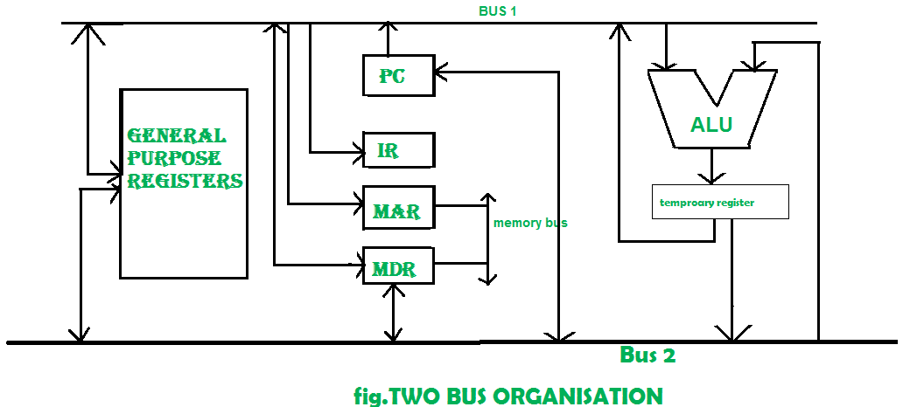
Common Buses for Input and Ouput

Slide 24
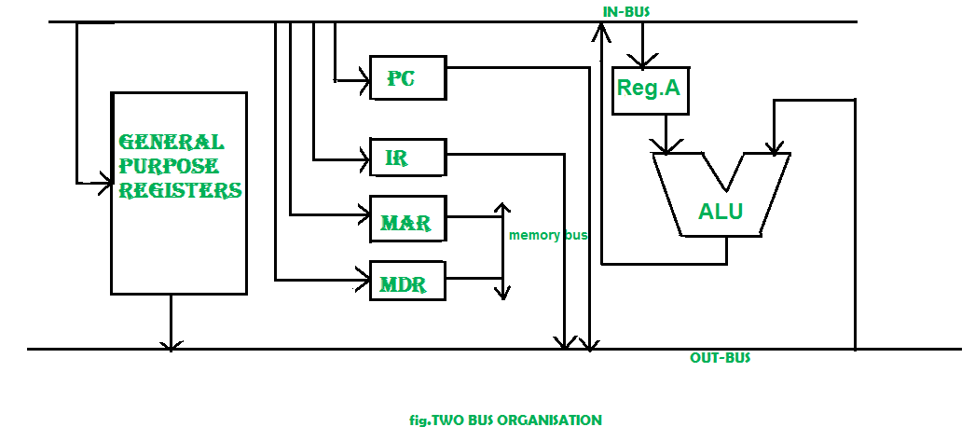
In Bus- Out Bus

Slide 25
Three Bus Organization
In three bus organizations we have three buses, OUT bus1, OUT bus2, and an IN bus. From the OUT buses, we can get the operand which can come from the general-purpose register and evaluated in ALU and the output is dropped on IN Bus so it can be sent to respective registers. This implementation is a bit complex but faster in nature because in parallel two operands can flow into ALU and out of ALU. It was developed to overcome the busy waiting problem of two bus organizations. In this structure after execution, the output can be dropped on the bus without waiting because of the presence of an extra bus.

Slide 26
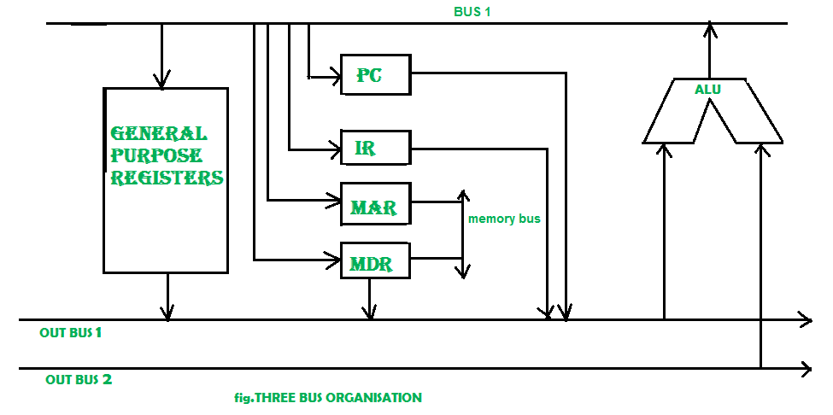
Three Bus Organization

